Slide 1
BOOK REVIEW APPLICATION
MANOJ E AM.EN.U4CSE17311
RAJENDRAN K AM.EN.U4CSE17313

Slide 2
FUNCTIONALITIES
USER REGISTRATION
ADD BOOKS
VIEW BOOKS
SAVE BOOKS
RATE BOOKS
ADD REVIEWS
VIEW REVIEWS

Slide 3
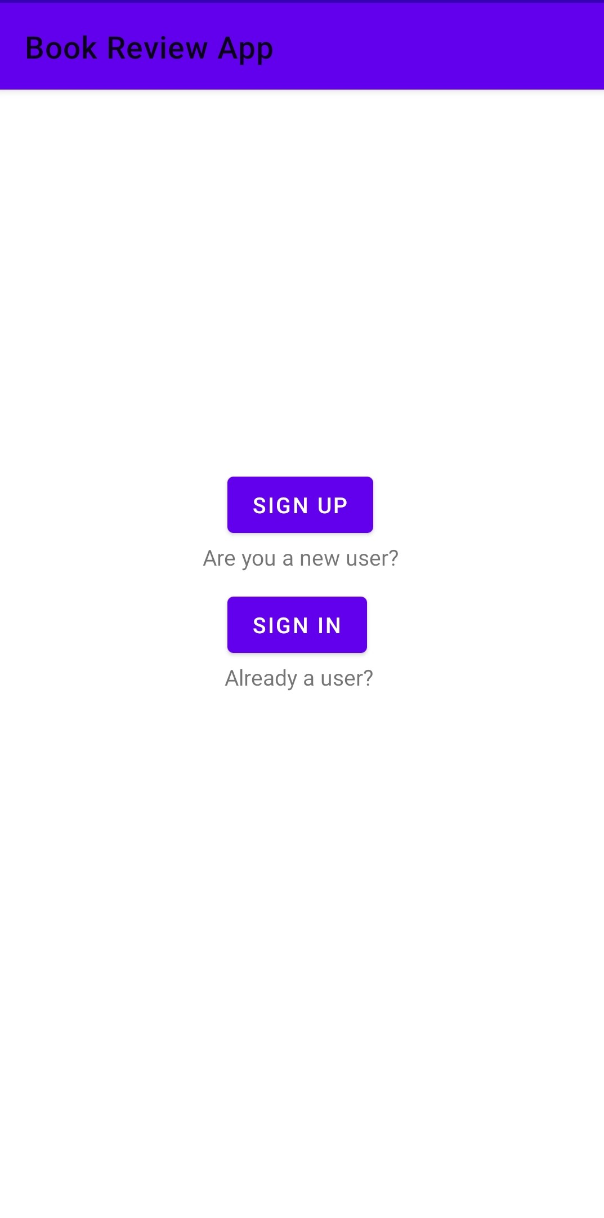
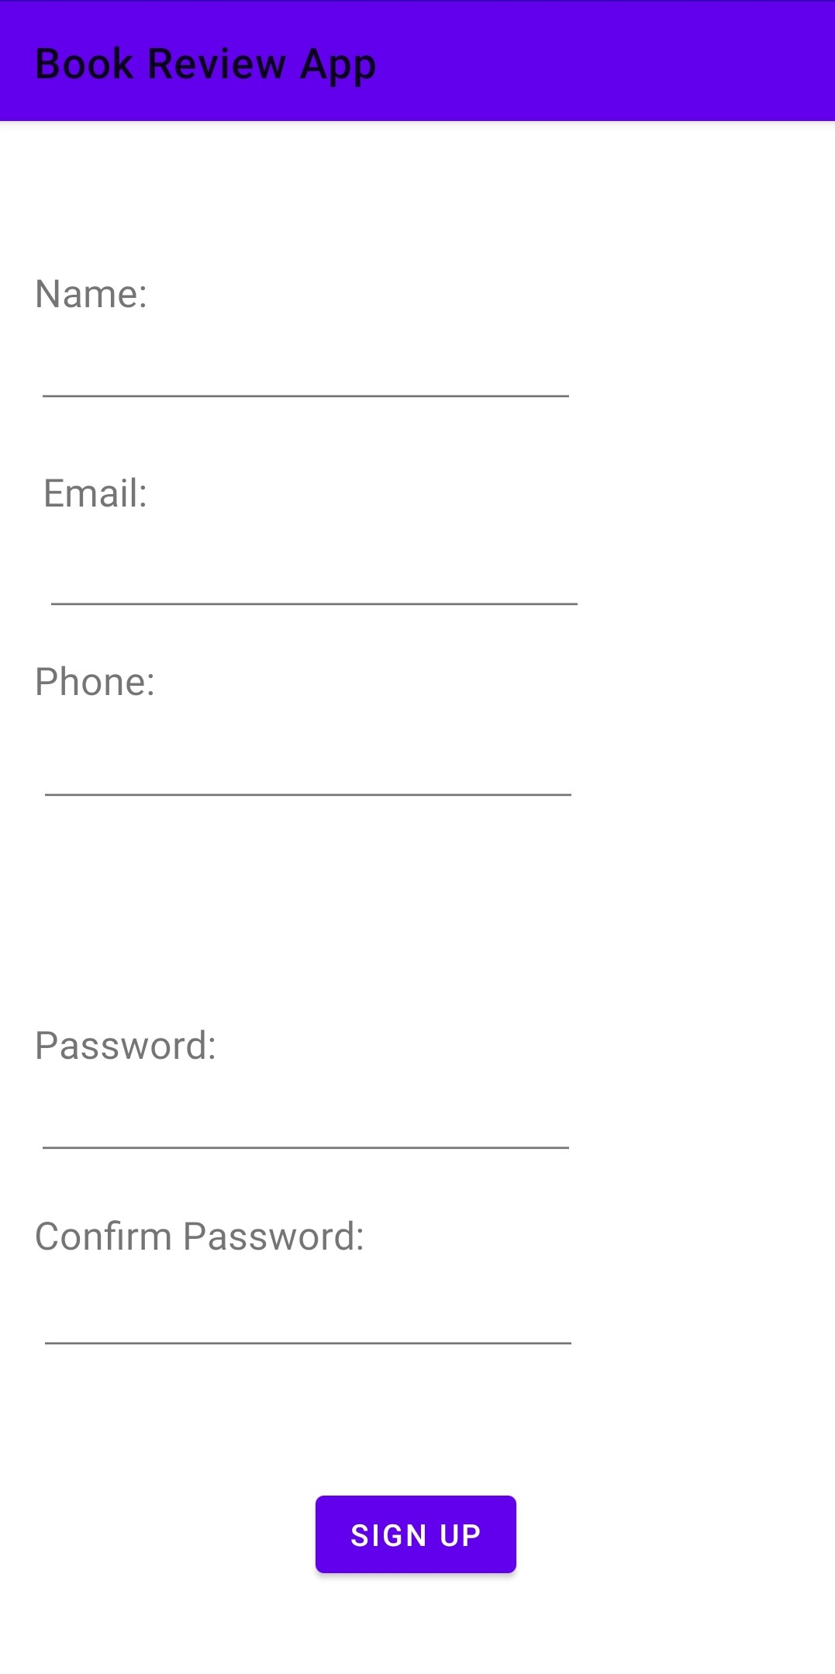
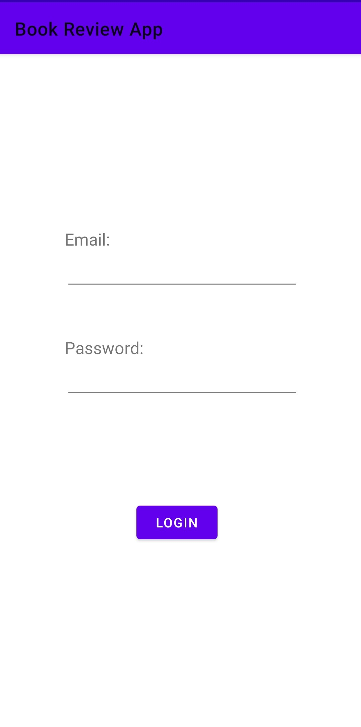
USER REGISTRATION
HOME PAGE
SIGN UP
SIGN IN

Slide 4

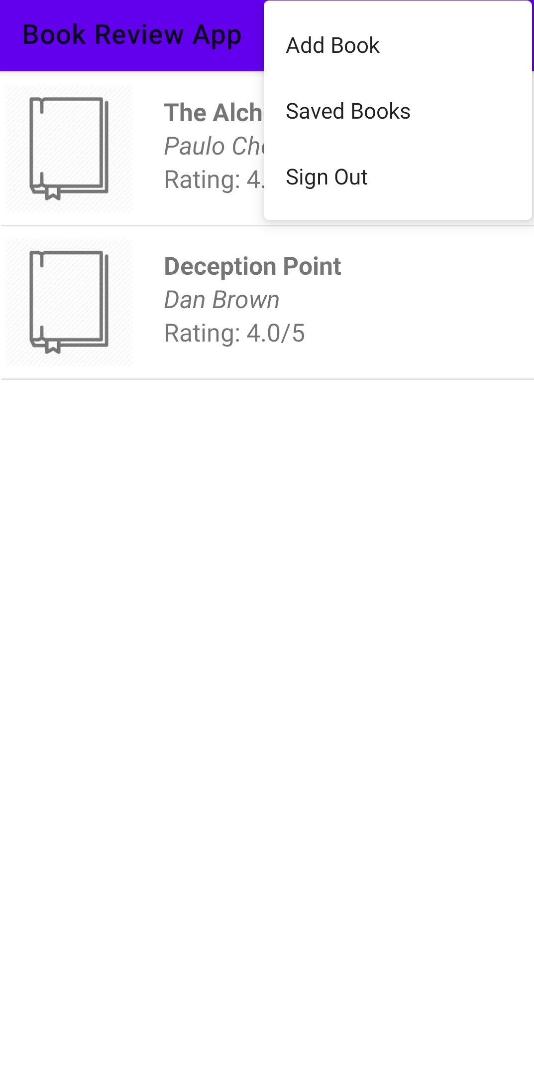
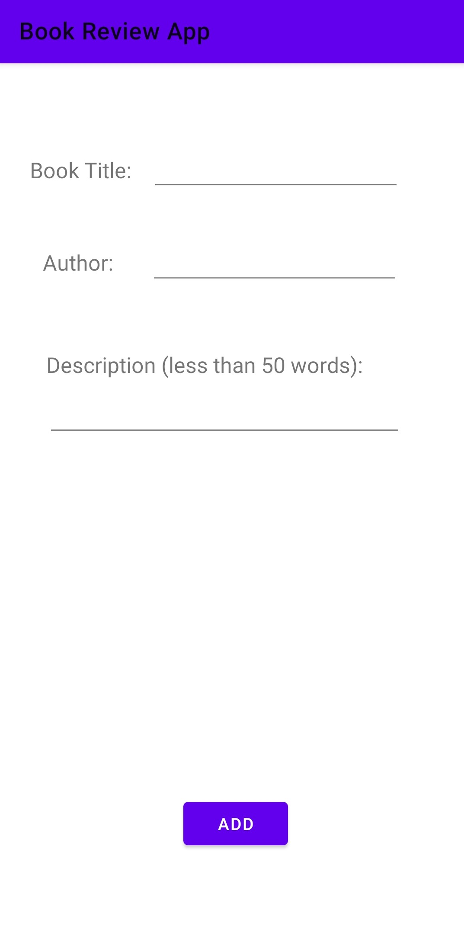
ADD BOOKS
BOOKS LAYOUT
ADD BOOK
FILL DETAIL

Slide 5

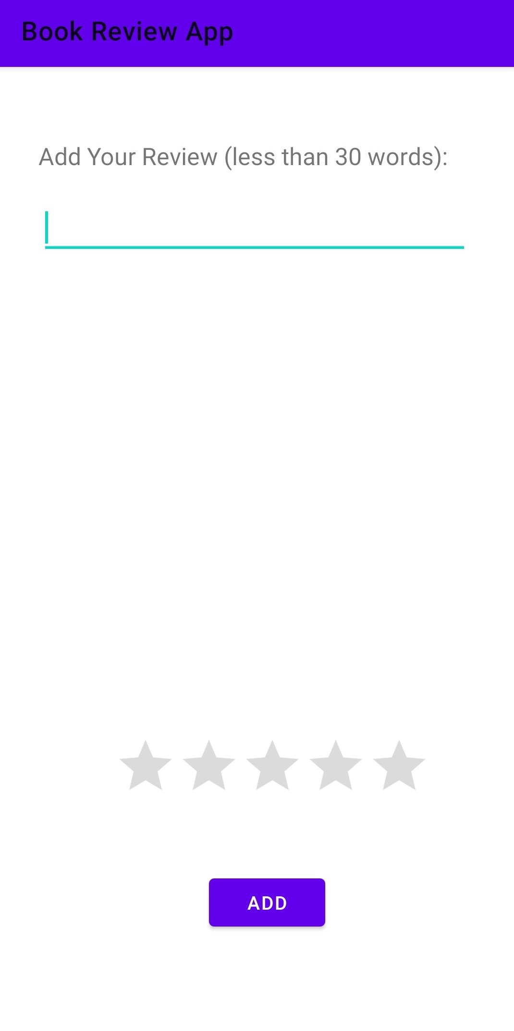

ADD REVIEWS
BOOK DETAILS
ADD REVIEW
VIEW REVIEW

Slide 6
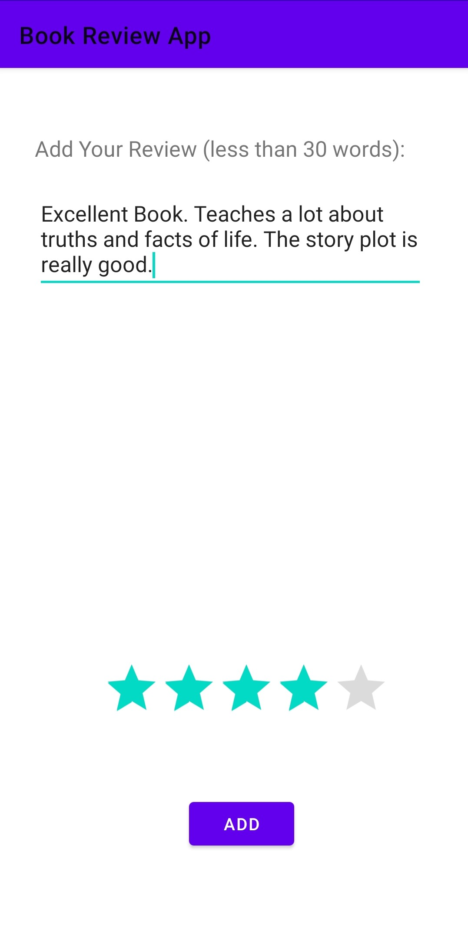
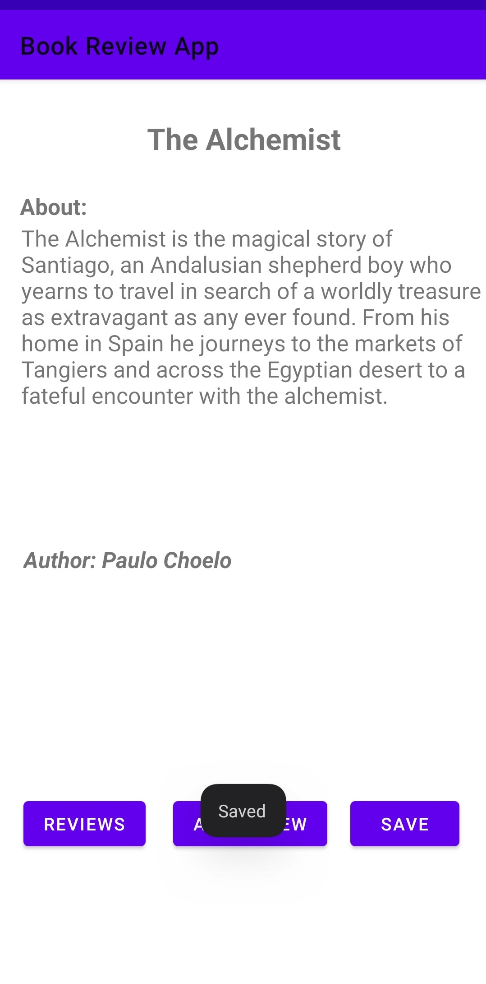

RATE AND SAVE BOOKS
RATE BOOK
SAVE BOOK
SAVED BOOK

Slide 7
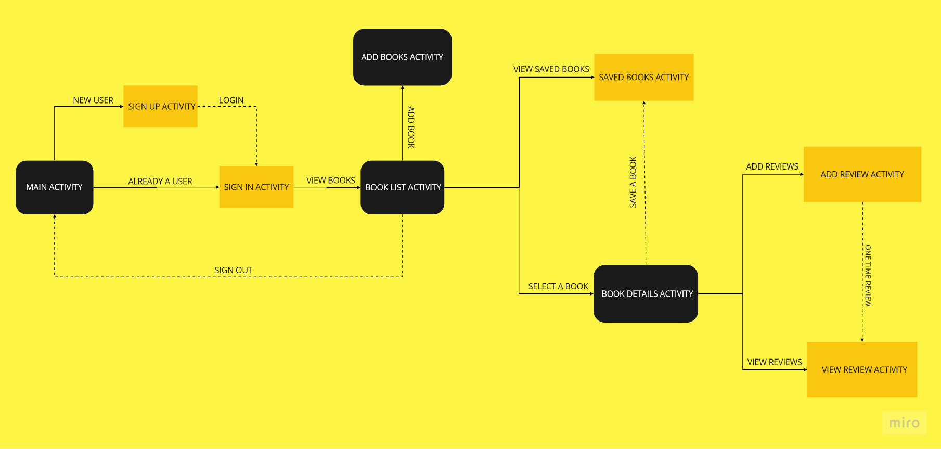
ARCHITECTURE

Slide 8
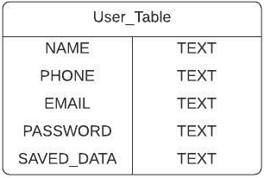
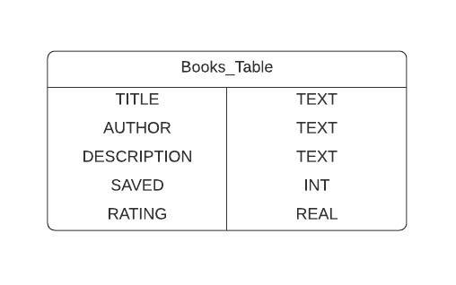
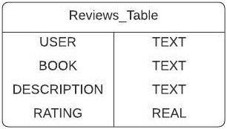
DATABASE

Slide 9
THANKYOU

